Slide 1
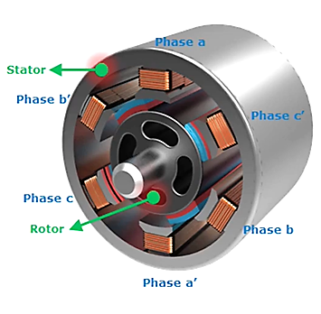
Permanent Magnet Synchronous Motor
Advantages
• Speed is constant irrespective of loads
• Ability to control power
• Mechanically more stable
• High efficiency Disadvantages
• Requires DC excitation if no permanent magnets used
• Permanent magnets are expensive
• Unless incoming supply frequency is adjusted, no possible way to adjust speed

